Slide 1
Beyond360 Publicity
Dynapar Board Recee Phase 3, May 2024 Ahmedabad

Slide 2
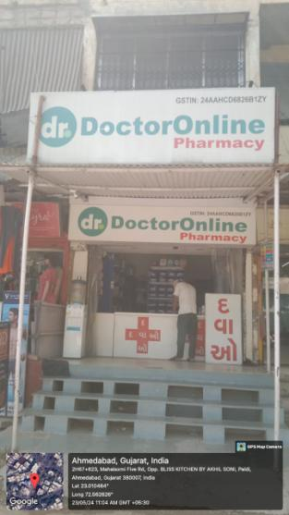
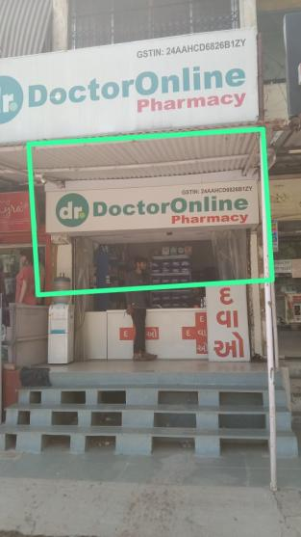
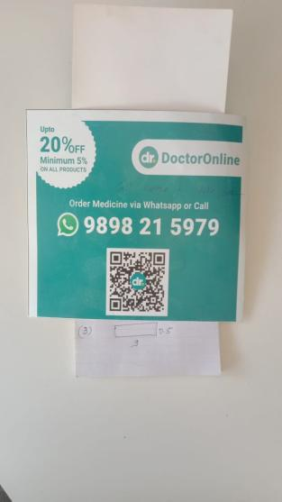
Shop Name : DR Online
Location : Paladi, 9898215979 amd
Board Size : 9 X 2.5
Board Type : NLB or GSB ( Before process Re confirm what kind of board we are providing)
OK
NLB

Slide 3
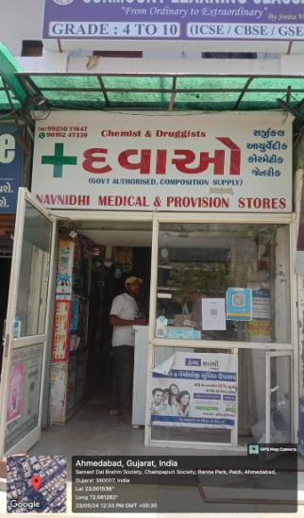
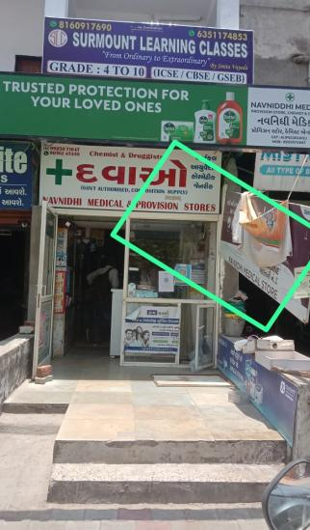
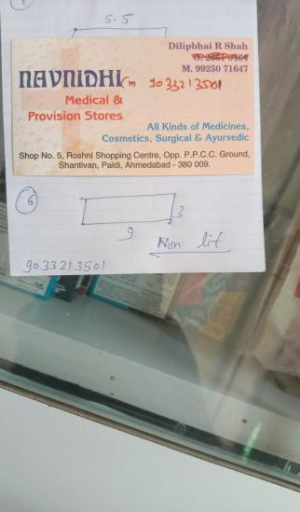
Shop Name : Navnidhi Medical & Provision Store
Location : Shop No 5, Roshni Shopping centre, Paladi, Amd. Dilip Bhai 9033213501
Board Size : 9 X 3
Board Type : NLB on side riling
OK
NLB

Slide 4
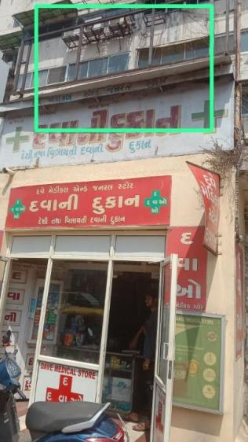
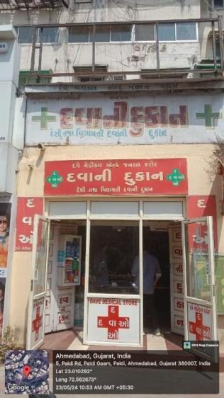
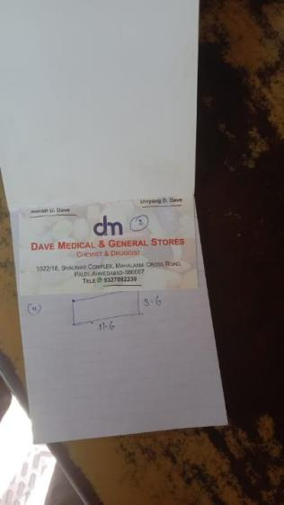
Shop Name : Dave Medical & General Store
Location : Shop No 1022/18, Shalimar Complex, Mahakali Cross Road, Paladi, Amd. Divyang Bhai 9327082239
Board Size : 11.6 X 3.6
Board Type : NLB on upper frame
OK
NLB

Slide 5
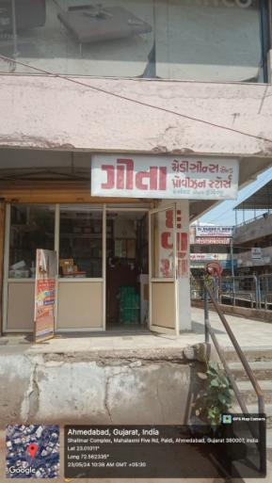
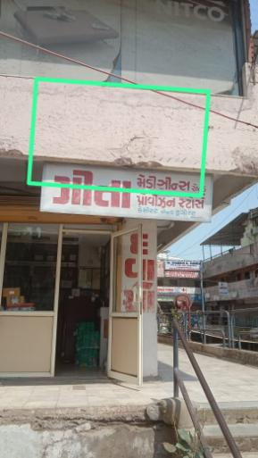
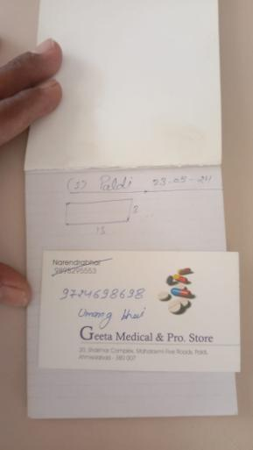
Shop Name : Geeta Medical & Provision Store
Location : Shop No 20, Shalimar Complex, Mahakali Five Road, Paladi, Amd. Umang Bhai 9724698698
Board Size : 13 X 3
Board Type : NLB

Slide 6
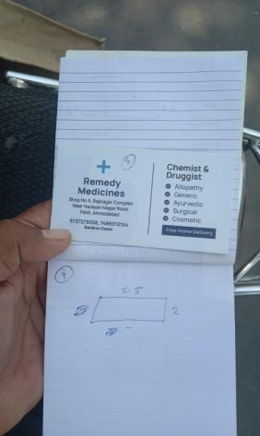
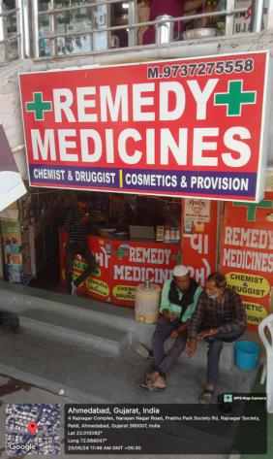
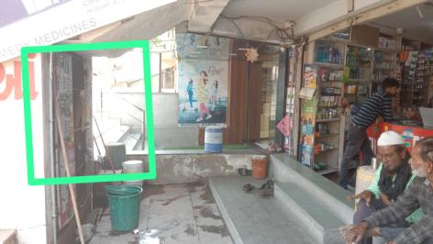
Shop Name : Remedy Medicines
Location : Shop No 5, Rajnagar Complex,Nr Naryan Ngr Rd, Paladi, Amd. Sarfaraz Bhai 9737275558
Board Size : 5.5 X 2
Board Type : NLB under the stairs

Slide 7
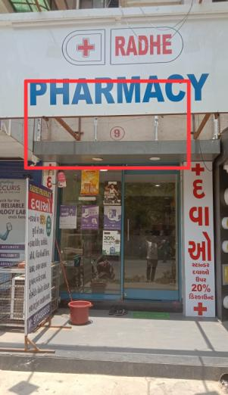
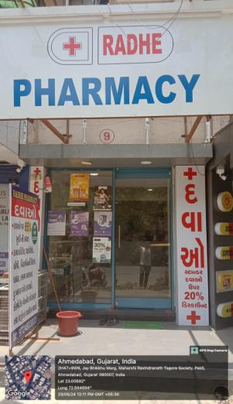
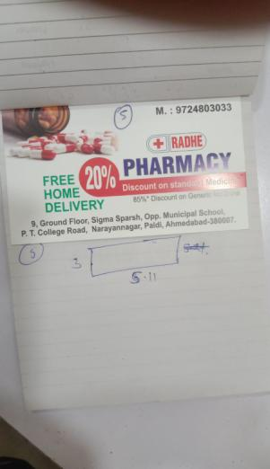
Shop Name : Radhe Pharmacy
Location : Shop No 9, GF, Sigma Sparsh, opp MC School, PT RD, Narainnagar, Paladi, Amd.9724803033
Board Size : 5.11 X 3
Board Type : NLB under the main board
OK
NLB

Slide 8
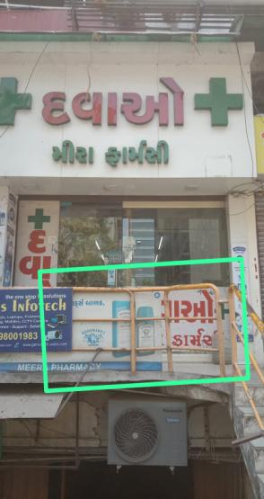
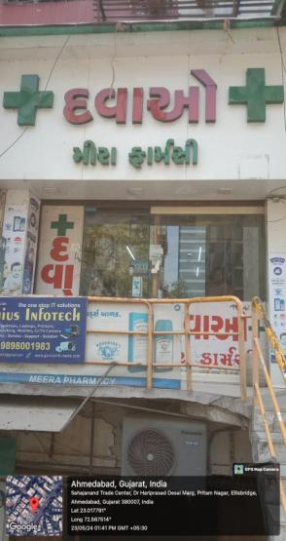
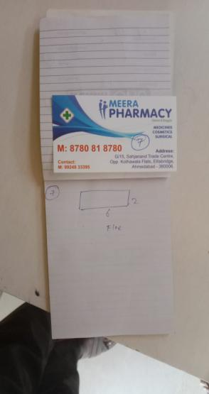
Shop Name : Meera Pharmacy
Location : Shop No G/15, Sahajnand Trade Centre, opp Khotawala Flats, Elleisbridge, Amd.8780818780
Board Size : 6 X 2
Board Type : NLB on Railling
OK
NLB

Slide 9
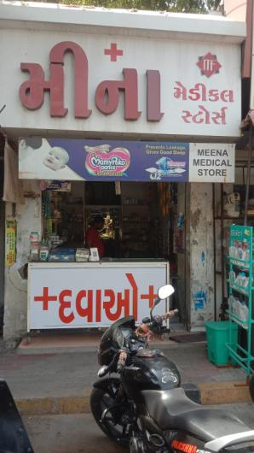
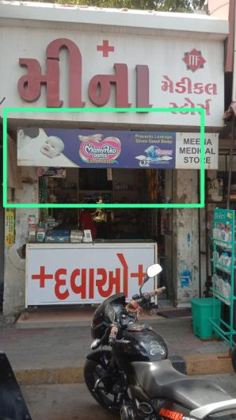
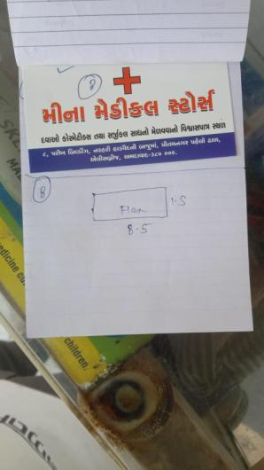
Shop Name : Meena Medical Store
Location : Shop No 8, Parikh Building, Pritam Nagar, Elleisbridge, Amd.
Board Size : 8.5 X 1.5
Board Type : NLB
OK
NLB

Slide 10
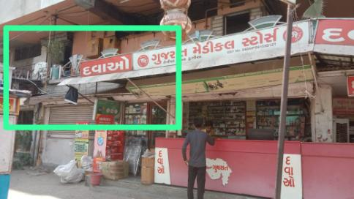
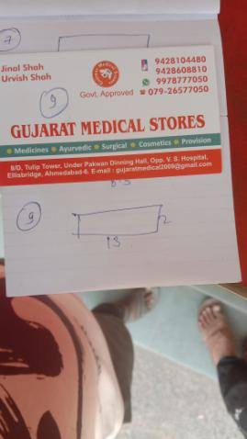
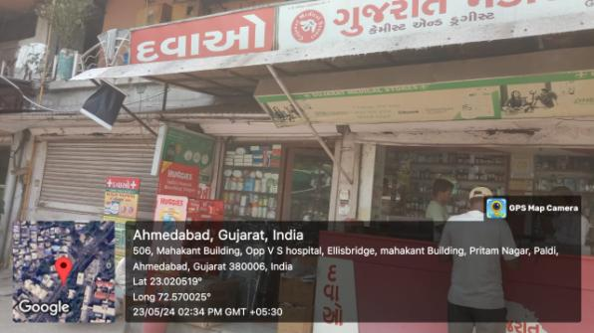
Shop Name : Gujarat Medical Stores
Location : Shop No 8D, Tulip Tower, Under Pakwan Dining,Ellisbridge, Jinal Shah 9428104480 Amd.
Board Size : 13 X 2
Board Type : NLB
OK
NLB

Slide 11
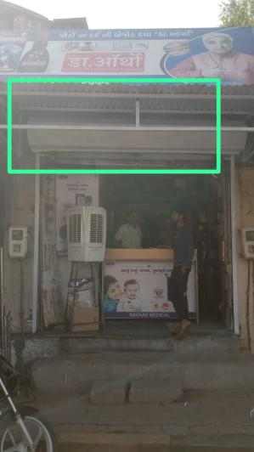
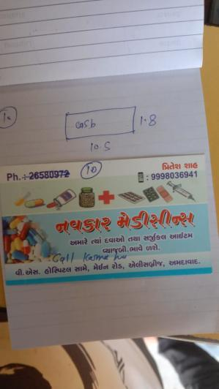
Shop Name : Navkaar Medicines
Location : opp VS Hospital, main Road, Ellisbridge, Amd. Pritesh Shah 9998036941
Board Size : 10.5 X 1.8
Board Type : NLB re call for confirmation
OK
NLB

Slide 12
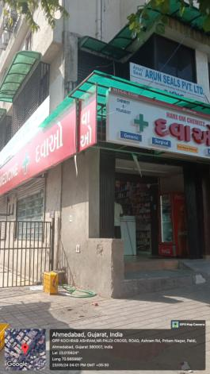
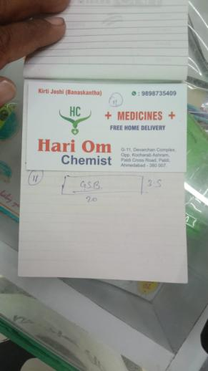
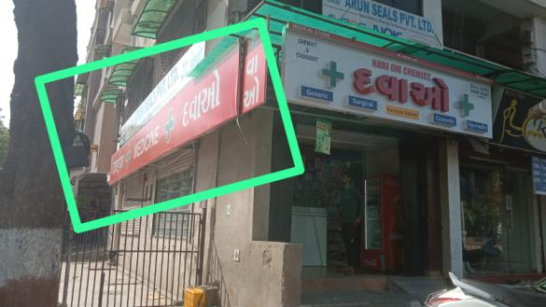
Shop Name : Hari Om Chemist
Location : Shop No D11, Devcharan Complex, opp kocharb ashram, Paladi Cross Road, Amd, Kirti Joshi 9898735409
Board Size : 20 X 3.5
Board Type : NLB

Slide 13
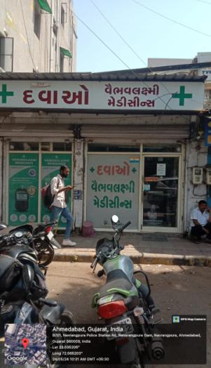
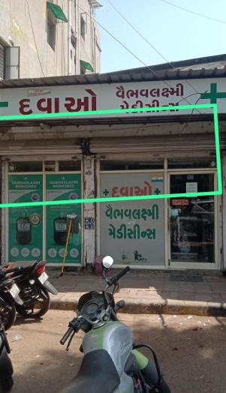
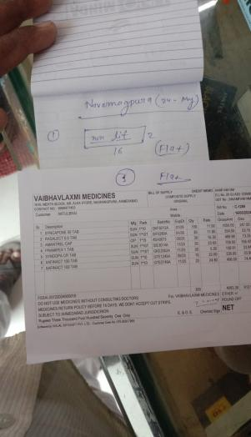
Shop Name : Vaibhavlaxmi Medicines
Location : Mehta Block, Nr Alka Store, navrang Pura, Amd 9998477453
Board Size : 16 X 2
Board Type : NLB
OK
NLB

Slide 14
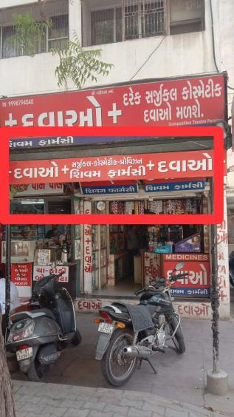
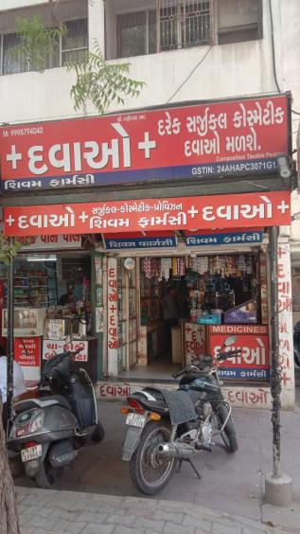
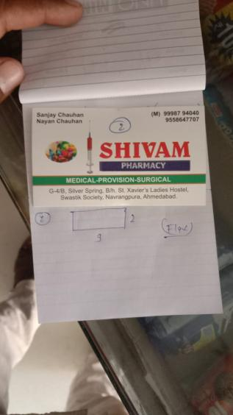
Shop Name : Shivam Pharmacy
Location : G4/B, Silver Spring,Swastik Society Navrangpura, Amd Sanjay Chauhan 9998794040
Board Size : 9 X 2
Board Type : NLB
OK
NLB

Slide 15
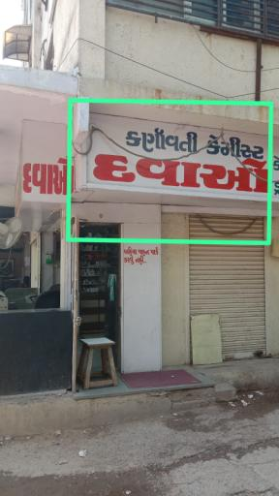
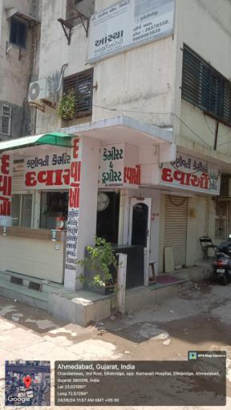
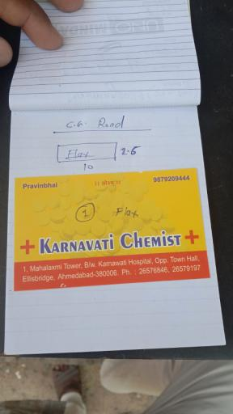
Shop Name : Karnavati Chemist
Location : Mahalaxmi Tower, B/W Karnavati Hospital, opp Town Hall,Ellisbrige, Amd. Pravin Bhai 9879209444
Board Size : 10 X 2.5
Board Type : NLB

Slide 16
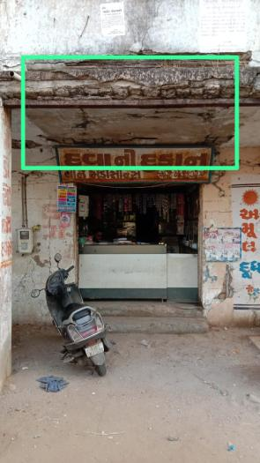
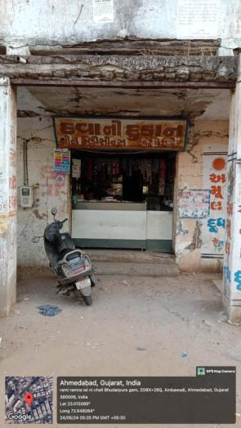
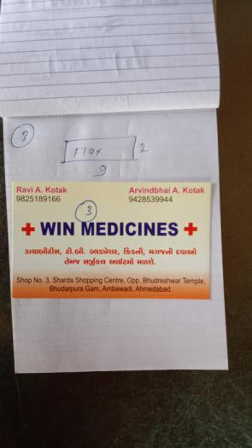
Shop Name : Win Medicines
Location : Shop No 3, Sharda Shopping Complex, opp bhadreshwar mandir, Bhadreshwar Gam, Ambawadi Amd. Ravi Bhai 9825189166
Board Size : 9 X 2
Board Type : NLB

Slide 17
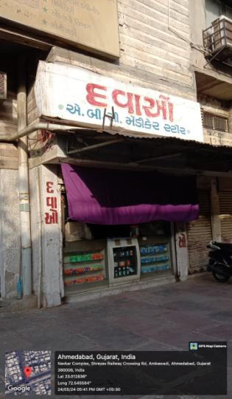
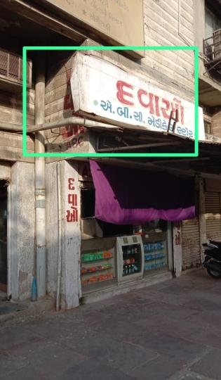
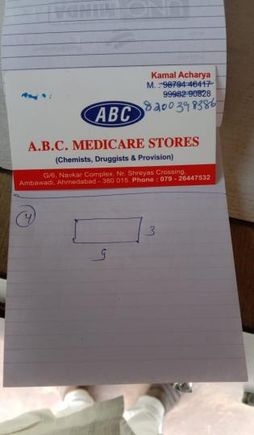
Shop Name : A.B.C. Medicare Store
Location : Shop No G6, Navkaar , Nr Shreyash Crossinh, Ambawadi Amd. kamal Bhai 8200398386
Board Size : 9 X 3
Board Type : NLB Left Side

Slide 18
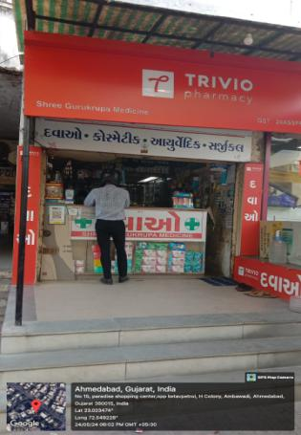
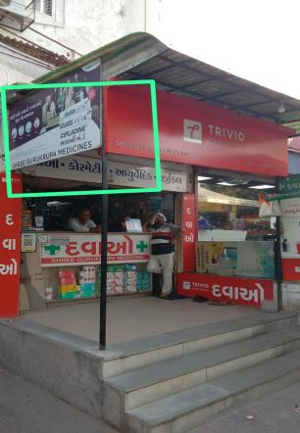
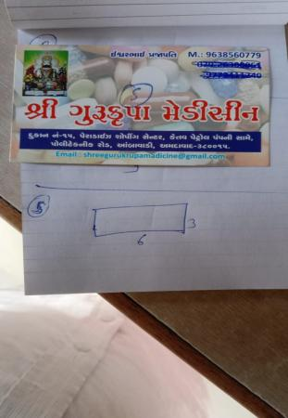
Shop Name : Shree Gurukripa medicine
Location : Shop No 15, Paradise Shopping Centre, Nr Petrol Pump, Polytecnic Rd, Ambawadi Amd. Ishwar Bhai 9638560779
Board Size : 6 X 3
Board Type : NLB

Slide 19



Shop Name : Deepak Medical Stores
Location : Shop No 15, Paradise Shopping Centre, Nr Petrol Pump, Polytecnic Rd, Ambawadi Amd. Ishwar Bhai 9638560779
Board Size : 6 X 3
Board Type : NLB
OK
NLB

Slide 20


Shop Name : Madhuvan Medical Store
Location : IIM Road vastrapur 9426412469
Board Size : 8 X 2
Board Type : GSB

Slide 21



Shop Name : Chandra Medicines
Location : A5 Palak Avenue, opp Amul parlor, vastrapur Hiren Shah 9714273202
Board Size : 10 X 3
Board Type : GSB only required GSB
OK
GSB

Slide 22



Shop Name : Yogeshwar Medical Store
Location : 3 Jugal Apartment Nr L.J College of Commerce, vastrapur Amd. 8980199454
Board Size : 10 X 3
Board Type : NLB Left side

Slide 23



Shop Name : Arihant Medicines
Location : 10 Palak Centre Nr Mangalmeet Enclave,Vastarpur Amd. Nimit Gandhi 9898466309
Board Size : 7 X 2
Board Type : NLB
OK
NLB

Slide 24




Shop Name : Gayatri Medicines
Location : GF Harmony Complex, Nr Konark Krishna tower, Nehrupark Vastrapur, Amd. 9879157865
Board Size : 10 X 2 & 5 x 2
Board Type : NLB
OK
NLB

Slide 25



Shop Name : Nishan Medicines
Location : 8 Hindola Complex, Lad Society rd, Nehru Nagar Vastrapur, Amd. 9904040026
Board Size : 12 X 3
Board Type : NLB
OK
NLB

Slide 26



Shop Name : Krishna Chemist
Location : ll Ruchi Apartment, lad Society rd, Vastrapur Amd. 9913095544
Board Size : 8 X 2
Board Type : GSB
OK
GSB

Slide 27



Shop Name : Om Medico
Location : L5, Ruchi Complex, opp Planet Health, Lad Society rd, Vastrapur Amd. 8511375232
Board Size : 8 X 1.5
Board Type : NLB 8X1.5 on shatter

Slide 28



Shop Name : Muskan Medicle & Orocision Stores
Location : G4, Pramnagar, opp, Lad Society Bodekdev, Amd.
Board Size : 4 X 2
Board Type : GSB

Slide 29



Shop Name : RR Medical & Cosmetics
Location : G5, Samtava, Mr Club Rd, Shela Amd, Suresh Bhai. 9173305339
Board Size : 7 X 2
Board Type : NLB in right side up

Slide 30



Shop Name : Darshan Medical & General Stores
Location : 4 Meghdeep Complex, Sandeesh Press rd, Bodekdev Amd, Ramesh Bhai. 9879160626
Board Size : 8 X 1.6
Board Type : NLB on pillar

Slide 31



Shop Name : Shanti Medical Stores
Location : G7, Meghdeep Complex, Sandeesh Press rd, Bodekdev, Vastrapur, Amd, Jayas Bhai.9913142964
Board Size : 10 X 2.3’’
Board Type : GSB
OK
GSB

Slide 32



Shop Name : Vastrapur Medicines
Location : H-1/3. Haridwar, b/h, Himalayan Arcade, opp Vastrapur lakem, Vastrapur, Amd, Chaten Bhai 9428500758
Board Size : 8 X 2
Board Type : NLB on Right Side
OK
NLB

Slide 33



Shop Name : Aatha Medical Stores
Location : G4. N D Complex, opp Guma Bus Stand, Ghuma Gum, Amd. Kalpesh patel 9558800911
Board Size : 6 X 2
Board Type : NLB

Slide 34



Shop Name : Umiya Medical & Provision Store
Location : 3, Siddhi 2, Nr IOC Petrol Pump, Bopal, Amd, 9687035077
Board Size : 9 X 1.3
Board Type : NLB
OK
NLB

Slide 35



Shop Name : Maruti Medical & Provision Store
Location : 3 Shree Mahalaxmi Villa Shoping Centre, opp lal gabi ashram, Bhopal Guma rd, Amd.Ravi Bhai 7984042168.
Board Size : 8 X 2
Board Type : GSB
OK
GSB

Slide 36



Shop Name : Nagraj Medical
Location : G28, Kabir Enclave, opp Homeopathic college, Bhopl, Guma rd, Gumha, Amd.Kanu Bhai 9924280053
Board Size : 10 X 2
Board Type : GSB
OK
GSB

Slide 37



Shop Name : Nagneshi Medical
Location : 01, Jaymadi Shantimurti Complex, Bopal, Guma rd, Gumha, Amd. 7023028368
Board Size : 13 X 3
Board Type : GSB

Slide 38



Shop Name : Bopal Medical & Provision Stores
Location : C9, Purushotam Socity, Bopal, Amd. 9974142099
Board Size : 8 X 3
Board Type : GSB

Slide 39



Shop Name : S P Pharma
Location : 5 New Nirav Shopping Centre, opp Bigdaddy Restorent, Bopal, Amd. 9998880166
Board Size : 5 X 2
Board Type : NLB

Slide 40



Shop Name : Dhanvantri Chemist
Location : G4, Omkar Complex, Nr Sterling City gate, Bopal, Amd. Vimal Bhai 9428910457
Board Size : 10 X 1.5
Board Type : NLB

Slide 41



Shop Name : Shree Revechi Medical Store
Location : Panchyat Shopping, Nr AMT Bus Stand, Memnagar, Amd, 9712600630
Board Size : 10 X 2.5
Board Type : GSB

Slide 42




Shop Name : Anurag Medical Stores
Location : Sardar Chowk, Memnagar Gam, Beside Bus Stand, Memnagar, Amd, Bharat Bhai 9925918249
Board Size : 6 X 3
Board Type : NLB

Slide 43



Shop Name : Shree Ambica Medical & Provision
Location : E6, Padma Ambica Complex, Opp Swagat Party Plot, Nhuyangdev Chaar Rasta,Amd, kanu Bhai 9824613355
Board Size : 9 X 2
Board Type : GSB
OK
GSB

Slide 44



Shop Name : Shree Keshav Medicine & Surgicals
Location : GF, Block B, Amrpali Complex, Nr D Mart, Ambli, Amd. 8238238623
Board Size : 8 X 2.6
Board Type : GSB -

Slide 45



Shop Name : Kailash Medicine
Location : 7 Shantiniketan Complex, Nr HB Kapadiya School Gurukul Rd, memnagar, Amd. Rajesh Bhai 9979774742
Board Size : 8 X 2.5
Board Type : NLB
OK
NLB

Slide 46



Shop Name : Modi Pharmacy
Location : B9, Gurukul Rd, B/H Vishkarma Ngr, Nr Shalimar Socity, Memnagar, Amd 7016631401
Board Size : 8 X 4
Board Type : GSB- Shopkeeper said I will trim the tree leaf

Slide 47



Shop Name : Shreeji Medical Stores
Location : 2 Sarvpriy Mall opp utsav aligance, Bhuyangdev 4 Rasta Sola Rd, Amd. 9898937177
Board Size : 9 X 3
Board Type : NLB
OK
NLB

Slide 48



Shop Name : Shivam Medical & Provision Stores
Location : GF Shubh Laxmi palace, Bhuyangdev 4 Rasta Sola Rd, Amd. 9439135990
Board Size : 18 X 2.5
Board Type : GSB
OK
GSB

Slide 49



Shop Name : Ambica Medical Store
Location : Bhuyangdev 4 Rasta Sola Rd, Amd. 9824688250
Board Size : 10 X 1.4
Board Type : NLB
OK
NLB

Slide 50



Shop Name : Arbuda Medical & Cosmetics
Location : 10, Agarwal Tower, Nr Bhuyungdev Rd, Amd. 9924057387
Board Size : 10 X 3
Board Type : GSB – Consider shop name as mention ARBUDA
OK
GSB

Slide 51



Shop Name : Sanjay Medical Stores
Location : 30, Agarwal Tower, Nr Bhuyungdev Rd, Amd. 9586955490
Board Size : 7 X 4
Board Type : NLB – ON RIGHT WALL

Slide 52



Shop Name : Jay Dola Medical & Provision Stores
Location : Arjun Complex ,Vijaynagar, Nawa Wadaj, Ahmedabad 9898078008
Board Size : 9 X 3
Board Type : GSB

Slide 53



Shop Name : Gayatri Medical Stores
Location : 4-B,Shop No-1, Dushyant Park Society , Amd. 7046583828
Board Size : 12 X 2
Board Type : NLB
OK
NLB

Slide 54



Shop Name : Maa Umiya Medical Stores
Location : 63, Shreeji Vibhag-1 Balolnagar Char Rasta, Ranip, Amd. 9824555304
Board Size : 7 X 3
Board Type : GSB
OK
GSB

Slide 55



Shop Name : Shree Meladi Medical & General Stores
Location : B-2, Pooja Apartment, B/H Ranip Busstand, Ranip, Amd. 9924184624
Board Size : 9.6 X 2.6
Board Type : GSB

Slide 56



Shop Name : Mahalaxmi Medical & General Stores
Location : Shop no 8, Suryadeep Complex ,Bobin Factory ,Ranip Amd. 8828084444
Board Size : 10 X 3
Board Type : GSB (Name Bada Likha Hua Chahiye)

Slide 57



Shop Name : Pragati Medical Stores
Location : Shop no 10, Swaminarayan Park 3,opp Ambika wadi, Ranip, Amd, 9898222977
Board Size : 9 X 4
Board Type : GSB

Slide 58



Shop Name : Patel Chemist
Location : Shop no 18, Swaminarayan Park 3,opp Ambika wadi, Ranip, Amd, 9898222977
Board Size : 9 X 2.5
Board Type : GSB

Slide 59



Shop Name : Angira Medicines
Location : 10/2 Sakhalchand Ni wadi,Ranip, Amd, 8401447496
Board Size : 6 X 2
Board Type : NLB
OK
NLB

Slide 60



Shop Name : Mahesh Medical Stores
Location : Ranip, Amd. 9825522385
Board Size : 9 X 2
Board Type : NLB
OK
NLB

Slide 61



Shop Name : Swaminarayan Medical
Location : 6 Raj Banglows Shopping Centre, Nr Swagat Hall balmandir, Ranip, Amd. 9998648241. 9173230552
Board Size : 9 X 2.5
Board Type : GSB
OK
GSB

Slide 62



Shop Name : Jalaram Medicines
Location : Near Balkrishna mandir, Ranip, Amd. 9824312751
Board Size : 10 X 2.5
Board Type : NLB
OK
NLB

Slide 63



Shop Name : K.D. Medicines
Location : Sudarshan Complex, Ganesh College Rd, Vidhyavihar Society, Ranip, Amd. 9624327408
Board Size : 9 X 1.5
Board Type : GSB
OK
GSB

Slide 64


Shop Name : Anand Medical Stores
Location : Prernatirath Desasra Rd, Viraj Ngr, Satalight, Amd. 9099555344
Board Size : 6X3
Board Type : NLB
OK
NLB

Slide 65



Shop Name : Moonlight Medical & General Stores
Location : Thakrovas Nr Bus Stand Thaltej, Amd. Bhadresh Bhai 9429969560
Board Size : 8.5X3
Board Type : GSB

Slide 66



Shop Name : Kruti Chemist
Location : Thakrovas Thaltej, Amd. Vinod Bhai 9998785495
Board Size : 9 X 2.5
Board Type : GSB above the shop
OK
GSB

Slide 67



Shop Name : Shree Mallinath Medical & Provision Stores
Location : Thakrovas Nr Mandir, Thaltej Gam,Theltaj Amd. 9825529206
Board Size : 8 X 2.5
Board Type : GSB above the shop

Slide 68




Shop Name : Jalaram Medical Stores
Location : 137/17 Ambika Ngr, Nr Vegitable Mkt, Thaltej Gam,Theltaj Amd. 9825529206
Board Size : 8 X 3.5 Front & 3.5 x 4 Left side
Board Type : GSB

Slide 69



Shop Name : Shreeji Pharmacy
Location : 19/20, Patel estate, Ambika Ngr, Nr Vegitable Mkt, Thaltej Gam,Theltaj Amd. 9537821397
Board Size : 6.5 X 2.5
Board Type : NLB Above the board
OK
NLB

Slide 70



Shop Name : Mahadev Medical Stores
Location : Dwarkesh Complex, Ambika Ngr, opp Rotla Kendra,Thaltej Gam, Amd. 9737274649
Board Size : 8 X 3
Board Type : GSB
OK
GSB

Slide 71



Shop Name : Royal Medical Store
Location : GF 12, Ora Bela Complex, Nr, Haritage Banglow, Hebatpur Thaltej, Amd. Laxman Bhai 9925042277
Board Size : 9 X 3
Board Type : GSB
OK
GSB

Slide 72



Shop Name : Decent Pharmacy
Location : 27-A , Ground Floor ,Orchid the Shopping Mall, Thaltej, Amd. 8460622762
Board Size : 9 X 2
Board Type : GSB

Slide 73




Shop Name : Lifeline Pharmacy
Location : 16 , Paradise Appartment ,Opp. Shyam Villa-2,Bopal , Amd. 9327015505
Board Size : 6 x 4
Board Type : GSB

Slide 74



Shop Name : Dave Medicare
Location : 6/A Orchid Mall, Nr. Govardhan Party Plot, Thaltej Amd. 9998517041
Board Size : 1.5 x 5
Board Type : NLB
OK
NLB

Slide 75




Shop Name : Shree Ram Medical
Location : B/4 Orchid Mall, Shanskruti Complex, Bopal , Amd. 7023840127
Board Size : 7 x 2.5
Board Type : GSB

Slide 76



Shop Name : Satej Medical Store
Location : 5, Maurya Appt., Opp. To Cambay Grand Hotel, Thaltej, Amd. 9727060401
Board Size : 2.5 X 8
Board Type : NLB
OK
NLB

Slide 77




Shop Name : Radhe Pharmacy
Location : Shop No B-5 ,Ganesh Krupa Tenament , DPS School Road Bopal, Amd. 7359988980
Board Size : 8 x 2
Board Type : GSB

Slide 78




Shop Name : Mahadev Medical Store
Location : 47/462, paiki Shop No. 4 & 5, Illora App/ Nr Tulip Bunglows ,Thatej Amd. 6377825306
Board Size : 6 x 2
Board Type : GSB (Name Bade Size me Chahiye)

Slide 79



Shop Name : Shree Matangl Medicine
Location : Shop No-2, Panchmukhi Elegance, Opp. Bopal Lake, ISRO Road, Bopal, Amd. 9227451047
Board Size : 10 x 3
Board Type : GSB

Slide 80



Shop Name : Vasant Medical and General Stores
Location : Thaltej, Amd. 9925862688
Board Size : 2 x 15
Board Type : GSB (Name Bade Size me Chahiye)

Slide 81



Shop Name : Hinglaj Medical Stores
Location : 205/11, Riddhi Siddhi Co.Op Ho. Soc., Thaltej, Amd. 9924050835
Board Size : 3 x 13
Board Type : NLB

Slide 82



Shop Name : Shiv Medical & Provision Store
Location : 201, Riddhi Siddhi Appt., Opp. Ajanta Elora Bus Stop, Thaltej, Amd.
Board Size : 1.5 x 9
Board Type : NLB

Slide 83



Shop Name : Bopal Care Pharmacy
Location : Shop 3, Someshwar Residency , Ghuma, Amd. 6354974656
Board Size : 6.5 x 3
Board Type : GSB

Slide 84



Shop Name : Royal Medicines & Cosmetics Store
Location : 9, Saundarya Apartment Shopping Center, Surdhara Circle, Thaltej Amd. 9327637928
Board Size : 3 X 26
Board Type : GSB
OK
GSB

Slide 85



Shop Name : Ganesh Medicines
Location : B-11, Ground Floor, Amidhara Shopping Center, Bopal, Amd. 9909990372
Board Size : 8.5 X 2.5
Board Type : GSB

Slide 86



Shop Name : Paras Medicines
Location : GF-2, Binori Mebal, Pinnacle Bussines Park, Prahladnagar, Amd. 9998154929
Board Size : 3.6 X 6.11
Board Type : One Way Vision
OK

Slide 87



Shop Name : Shreeji Chemist
Location : 5, Yogiraj Avenue, Near Shreeji Enclave, Satellite,Amd. 9898394883
Board Size : 2 X 14
Board Type : NLB
OK
NLB

Slide 88



Shop Name : Laxmi Medicines
Location : G-26 Satyam Status, Visatnagar, Ramdevnagar Road, Amd. 9409144565
Board Size : 2 X 8
Board Type : NLB

Slide 89




Shop Name : Satyam Medical Store
Location : G-13, Satyam Status, Jodhpur, Satellite, Amd. 9879879567
Board Size : 5 X 2
Board Type : NLB

Slide 90



Shop Name : Jalaram Medical Stores
Location : G-17, Satyam Status, Jodhpur, Satellite, Amd. 8401750122
Board Size : 2 X 6
Board Type : NLB

Slide 91



Shop Name : Mahakali Medicines
Location : G-18, Satyam Complex, Opp. Balaji Garden Restaurent, Satellite, Amd. 9898601388
Board Size : 7 X 2
Board Type : NLB
OK
NLB

Slide 92



Shop Name : Shiv Shakti Medical Store
Location : Shop No. 4 ,Bhagvatinagar , Opp. Laxmikrupa Soc.,Vejalpur, Amd. 8735861393
Board Size : 10 X 1.5
Board Type : GSB
OK
GSB

Slide 93



Shop Name : Rosewood Chemist
Location : 15, Rosewood Estate, Opp.Prem Tirth Bunglows, Satellite,Amd. 9825529208
Board Size : 3 x 10
Board Type : GSB
OK
GSB

Slide 94



Shop Name : Purohit Medical Store
Location : 9, Nr. Akshar Hospital, Opp Water Tank, Vejalpur, Amd. 9909558550
Board Size : 8 X 3
Board Type : GSB
OK
GSB

Slide 95



Shop Name : Deendayal Pradhanmantri Jan Aushadhi kendra
Location : AB/9, Iswercharan Complex, Jodhpur Gam Road, Satellite, Amd. 9106913669
Board Size : 6.10” X 4.11”
Board Type : One Way Vision
OK

Slide 96



Shop Name : Mahadev Medical & General Stores
Location : Shop No. 1, Tekravas Vejalpur Gam, Vejalpur, Amd. 7758984719
Board Size : 5 X 1.10”
Board Type : NLB

Slide 97



Shop Name : Mahalaxmi Medical Stores
Location : 1, Vasudev Appt., Near Water Tank, Jodhpur, Amd. 8485954855
Board Size : 1.6” X 7
Board Type : NLB
OK
NLB

Slide 98



Shop Name : Satyam Healthcare
Location : 9, Jantanagar Market, Vejalpur, Amd. 9328259207
Board Size : 5 X 2
Board Type : NLB

Slide 99



Shop Name : Vidhya Medical and Surgical Store
Location : G-5,Shantisadan-2,Vejalpur, Amd. 9974606659
Board Size : 8 X 2.5
Board Type : GSB

Slide 100



Shop Name : Shree Dariyalal Medical & Provision Store
Location : 43, Shreyas Complex, Shree Nandnagarroad, Vejalpur, Amd. 9737300210
Board Size : 15 X 2.5
Board Type : GSB

Slide 101



Shop Name : Manoj Medical Store
Location : 1, Sanjivni Complex, Opp. Shrinandnagar Part-1,Vejalpur, Amd. 9173385643
Board Size : 9.5 X 1.5
Board Type : GSB

Slide 102



Shop Name : Harsiddhi Medical Store
Location : QQ8, Shantinath Complex, Opp. Shrinandnagar Part-1, Vejalpur, Amd. 8128922253
Board Size : 10.5 X 3
Board Type : GSB

Slide 103



Shop Name : Aswad Medical & Provision Store
Location : Shop No. 2 Ali Raza Complex, Vejalpur, Amd. 9265756417
Board Size : 10 X 2.5
Board Type : GSB

Slide 104



Shop Name : Sun Pharmecy
Location : 4,Kavita Shops Radio Mirchi Road, Satellite, Amd. 7043992234
Board Size : 7 X 2
Board Type : NLB

Slide 105



Shop Name : Angel Medicines
Location : 3, Silver Stone Flat, Vejalpur Road , Juhapura, Amd. 8347050991
Board Size : 10 X 2.5
Board Type : NLB ( add Mobile No. In Board)

Slide 106




Shop Name : Ashapura Medical Store
Location : 202, Rajivnagar-2,Satellite, Amd. 9662392192
Board Size : 3 X 10
Board Type : NLB
OK
NLB

Slide 107



Shop Name : Samandar Medical Store
Location : 79, Hajibava Park, Sonal, Vejalpur, Amd. 99778679444
Board Size : 1.5 X 4
Board Type : GSB (ADD PLUS SYMBOL)

Slide 108



Shop Name : Mangalam Medicines
Location : 3, Anand Mangal Complex, Satellite, Amd. 9904971719
Board Size : 10 X 3
Board Type : GSB
OK
GSB

Slide 109



Shop Name : Rajendra Medical and Surgical Store
Location : R-11, Kenyug Shopping Center ,Satellite, Amd. 9512127333
Board Size : 10.5 X 3
Board Type : GSB
OK
GSB

Slide 110



Shop Name : M. Narandas Pharmecy
Location : 6,Shivsagar Vibhag-1, Nr. Chokshi Park, Vejalpur, Amd. 6353267334
Board Size : 4.5 X 2
Board Type : NLB

Slide 111



Shop Name : Doli Medical Store
Location : Shop No. 3, Jivanji No Kuvo, Vejalpur, Amd. 9723741935
Board Size : 10.5 X 2.5
Board Type : GSB

Slide 112



Shop Name : Purav Chemist
Location : E-1, Saibaba Soc., Vastarapur Railway Crossing, Vejalpur, Amd. 8141431922
Board Size : 13 X 1.5
Board Type : GSB

Slide 113



Shop Name : Sanjari Medicines
Location : B-8/2,Nr. Zafar Hotel, Juhapura, Amd. 9427304394
Board Size : 7.9 X 3
Board Type : GSB

Slide 114
THANK YOU!

